Slide 1
Comparing Population Models for Epidemics: SIR, ESVIR, and Improvements
By: Ryeder Geyer, Josh Limon, Umut Dilsiz
Notes:
Comparing Population Models for Epidemics: SIR,ESVIR, and improvements

Slide 2
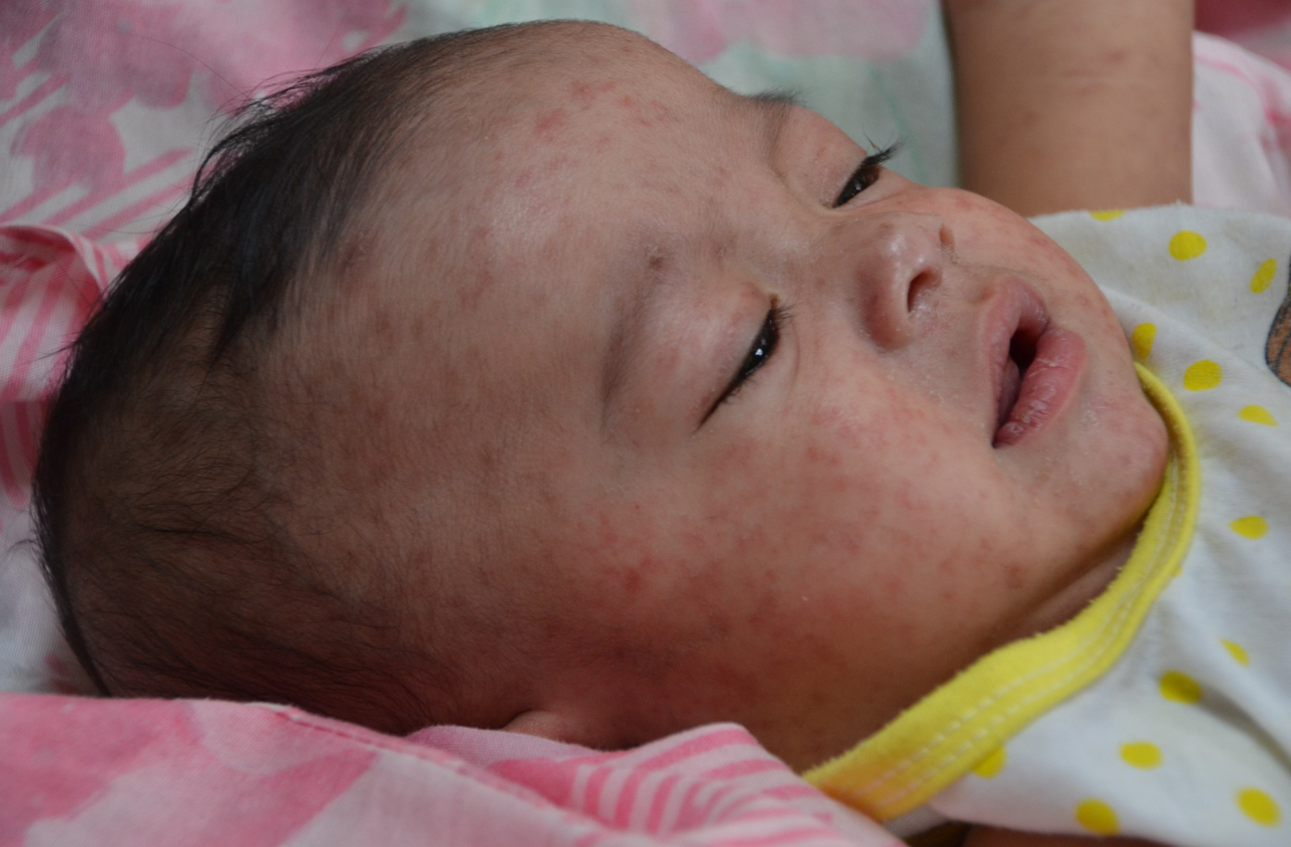
Introduction:
Epidemic mathematical models are used to predict the behavior of disease spread.
The simplest model is the SIR (Susceptible, Infected, Recovered) model.
This model tracks the development of these three populations using a system of linear first order differential equations
There are a variety of variations. In this presentation, we develop a new model using elements from old models, specifically, a three-population model and the ESIRV model.
Notes:
https://www.nature.com/articles/d41586-020-01011-6 (There was a 6500+ infected outbreak of Measles in the Democratic Republic of Congo)
Coronavirus R₀ was studied and corrected
It can be difficult to obtain R₀ values since getting infection data is extremely difficult to get accurate

Slide 3
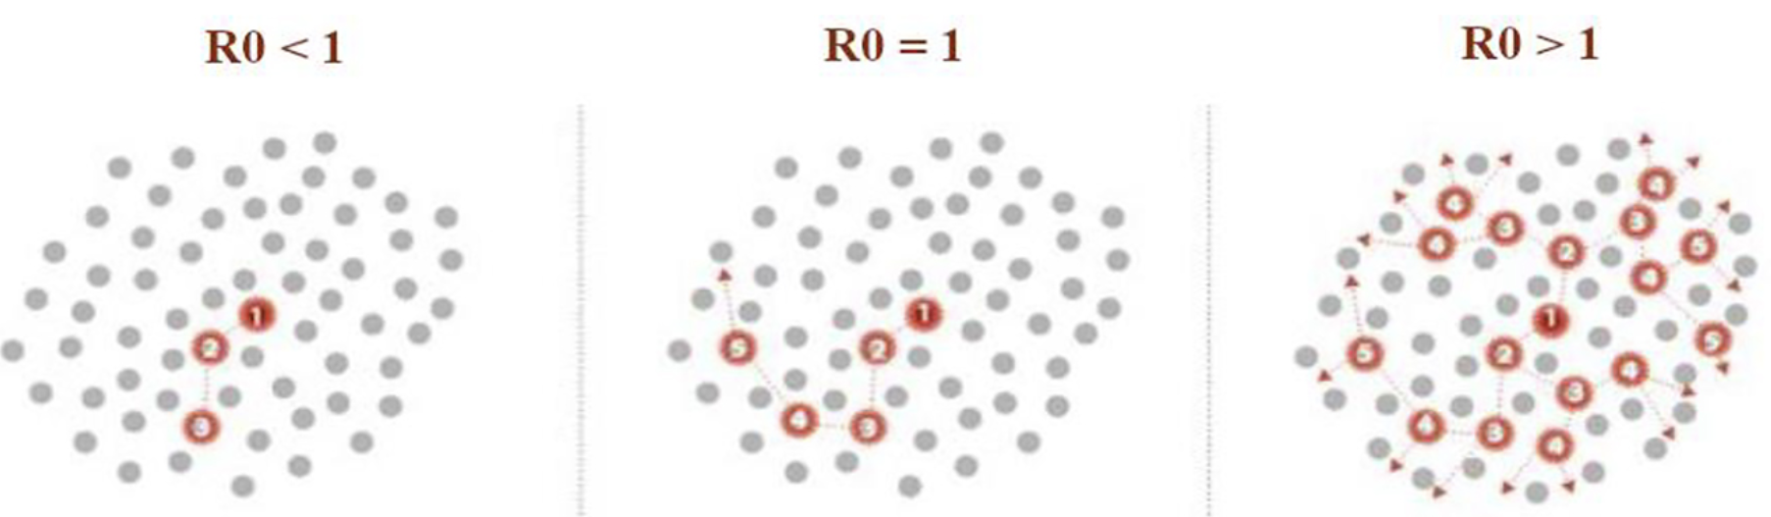
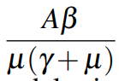
What is R₀?
R₀ is the average amount of infected individuals infected by a person assuming the population is exposed and susceptible.
It can be calculated as below (A = birth rate, µ is the death rate β is transmission rate, and γ is the recovery rate).
The value of R₀ is calculated as below
If R₀= 1, population is sustained; <1, epidemic dies out; >1 epidemic
Notes:
-R₀ is of high relevance because it gives a threshold for whether or not we have to worry about the long term behavior of a given disease.
-This is because the disease will die out or create an epidemic depending on if R₀ is above or below 1.
-R₀ comes from the SIR model and is shown on the slide.

Slide 4
More info about R0
If R0>1: each infected individual can infect more than one other individual. Thus, there can be an
epidemic spreading through the population;
If R0<1: an infected individual cannot infect more than one other individual. Therefore, there is no risk of an epidemic;
If R0=1: an infected individual can infect, on average, only one other individual. So, the disease persists without an epidemic

Slide 5
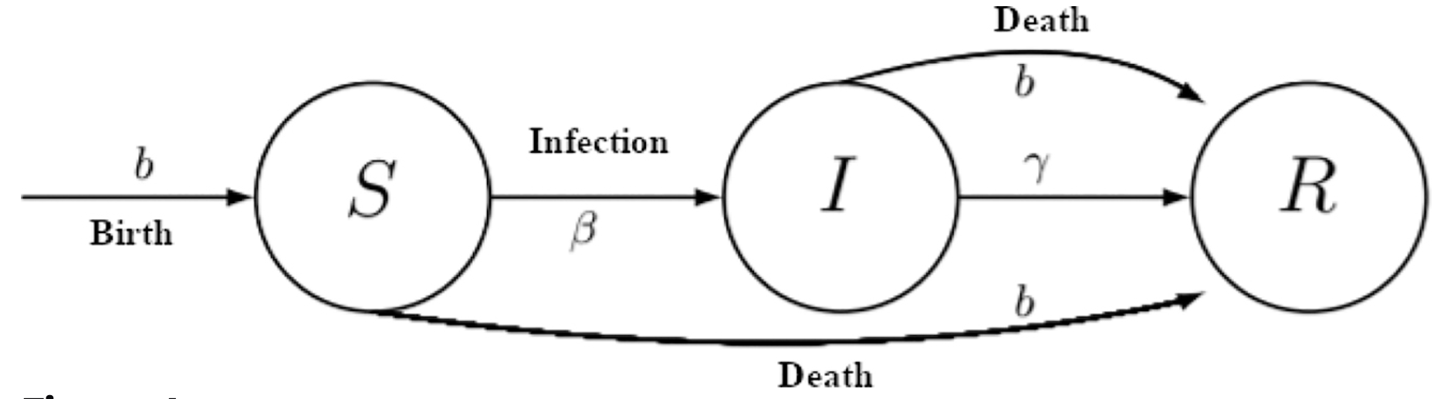
The SIR Model
The simplest model we have for simulating disease spread is the SIR (susceptible, infected, recovered) model.
We will set birth and death rates to simplify the model and allow for conservation of mass
Notes:
We can break break the population into 3 components
Susceptible population/infected population/recovered population
We assume these individuals are distributed throughout the population uniformly
We can construct equations modeling how members form one of these subpopulations move to others as we can see in the image.

Slide 6
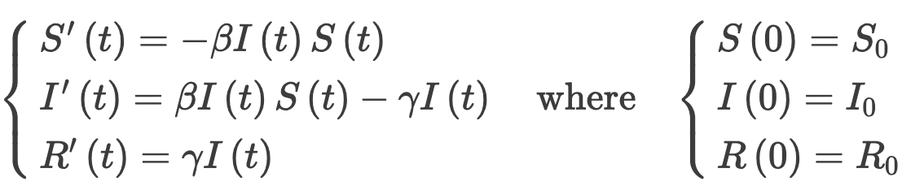
SIR Model
S(t)=susceptible population
I(t)=infected population
R(t)=recovered population
β=describes the likelihood that the disease is transmitted by exposure
γ= expresses the average recovery rate
Notes:
The size of the infected populations increases by when susceptible individuals become infected. The rate of this occurs increases when there are more susceptibles and when a larger overall population is infected.
Barring birth and death rates, the only change to the susceptible population is from members of the susceptible population moving to the infected population.
The only change for recovered population is when members of infected population recover.

Slide 7
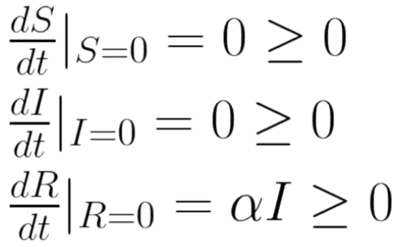
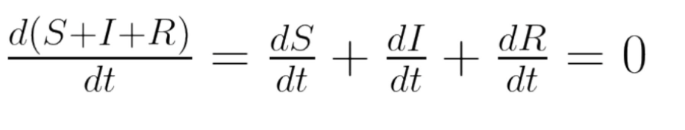
Non negativity and Conservation of Mass
Set birth and death rates to 0 for conservation of mass
Notes:
Given non negative inital populations, the populations will be always non negative
Becasaue we excluded birth and death rates the total population is constant

Slide 8
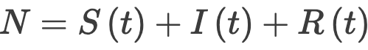
Model assumes a short time interval so that births and deaths (other than deaths due to measles) can be neglected
N = total population
S(t)=susceptible
I(t)=infected
R(t)=recovered

Slide 9
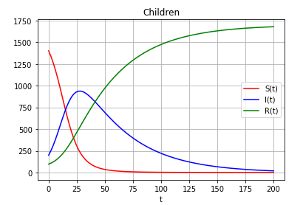
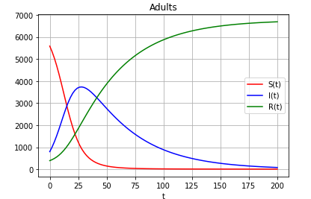
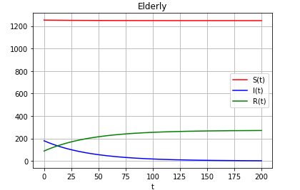
SIR Model for 3 independent age populations
Assume different initial populations
Children 17% , Adults 67.8%, Elderly 15.2% of total population N_0
Assume different transmission rates for each age group
𝛃_c > 𝛃_a >𝛃_e
Notes:
Beta can be the proportion of a population expected to be interacted with by a person infected assuming 100% infection rate or the proportion of the population infected by someone infected assuming total interaction from that infected person.

Slide 10
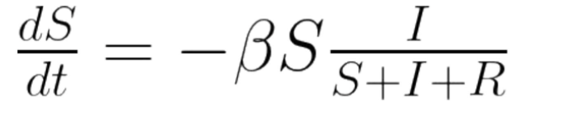
Susceptible Population
S(t)=susceptible
I(t)=infected
R(t)=recovered
β=describes the likelihood that the disease is transmitted by exposure

Slide 11
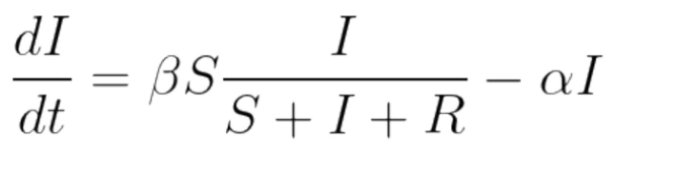
Infected Population
S(t)=susceptible
I(t)=infected
R(t)=recovered
β=describes the likelihood that the disease is transmitted by exposure

Slide 12
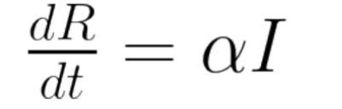
Recovered population
I(t)=infected
R(t)=recovered
Alpha=γ= expresses the average recovery rate

Slide 13
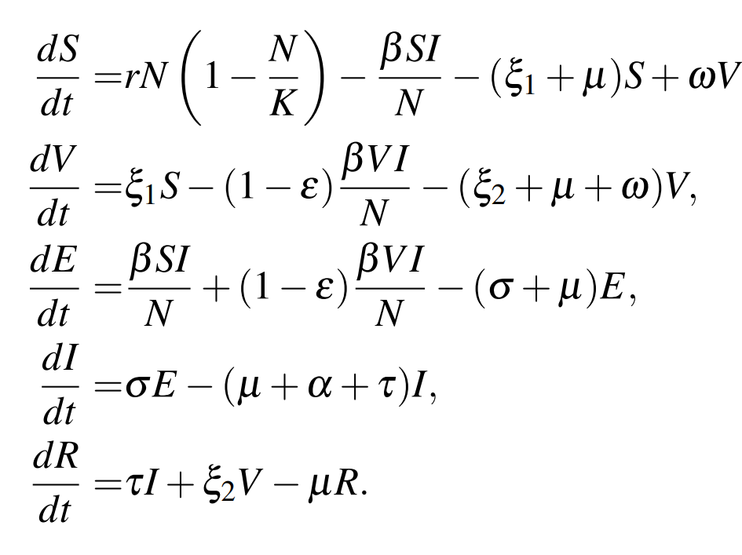
The ESIRV Model
r: birth rate
N: population size
K: population carrying capacity
β: exposure rate
ξ₁ : Vaccination #1 rate
ξ₂ : Vaccination #2 rate
μ: death rate of non-infected
ω: rate of vaccine #1 inefficacy
ε : rate of vaccine #1 effectively protecting against exposure
σ: rate of contracting infection after exposure
τ: recovery rate after infected
⍺: additional death rate for infected
Notes:
-Here we introduce the vaccinated and exposed groups and some new variables of interest are added. -We have to account for efficacy and inefficacy of the vaccine, rate at which vaccines are obtained. -Beta is one of the more intricate terms accounting for exposure rate of people to the disease from susceptible and vaccinated groups. -Also sigma is a new term

Slide 14
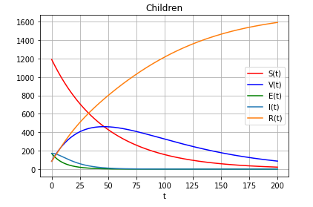
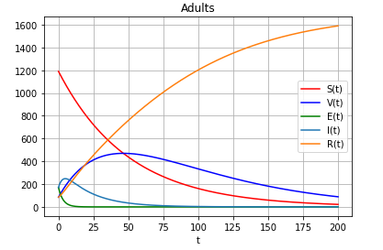
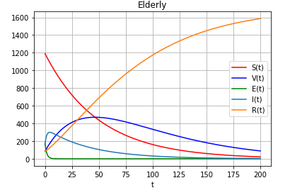
ESIRV for 3 independent populations
β (S,V → E), σ (E → I), τ (I→ R) different for each population
Allows for a more comprehensive analysis of isolated populations
Vaccination model greatly reduces infected population
Notes:
-Should be noted β (S,V → I) for I instead of E. So we see a strength of E, that people are not instantly infected.
-We see effectiveness of vaccination in reality.
-The 3 plots are the

Slide 15
How is ESIRV 3-population with Age Groups more useful than SIR?
The exposed population gives a more comprehensive way of representing self-isolation in the model
The vaccinated population accounts for people getting vaccinated and their reduced chance of infection
3-population model allows us to account for differences in the age groups such as recovery rate, or spreading rate.
Taking consideration of age-dependent risks
Recovery rates for different rates
Pattern of contacts between different age groups play essential role in determining the spread of disease (also a limitation because this requires using data for an accurate model)

Slide 16
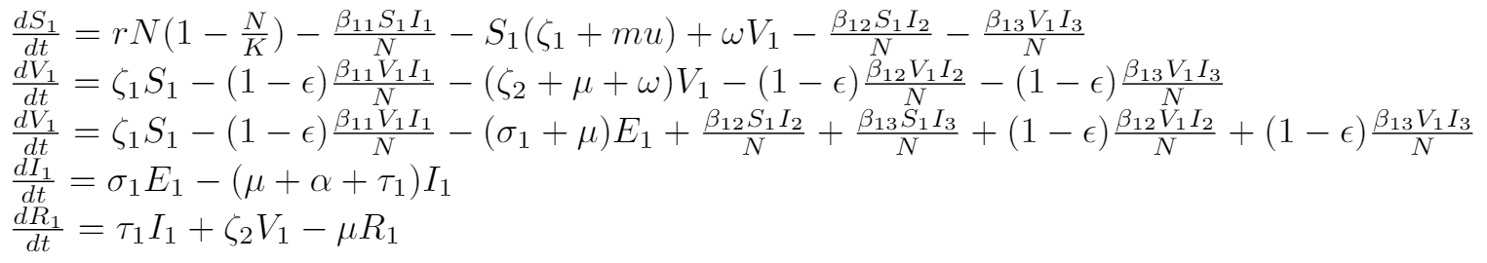
ESIRV for 3 age groups (Children, Adults, Elderly):
New Term Inclusions
𝛃_ij coefficient
Represents interaction rates between groups i and j
Coefficients are symmetric (i.e 𝛃_ij = 𝛃_ji)
𝛔_i
Rate from Exposed to Infected (within population i)
Strength of Immune System varies with age
𝛕_i
Recovery rate from Infected to Recovered (within population i)
Notes:
Zeta’s index has a different meaning from other variables.

Slide 17
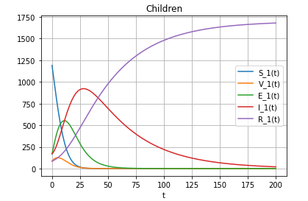
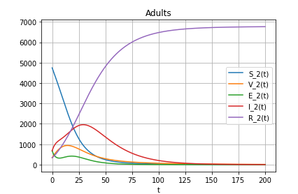
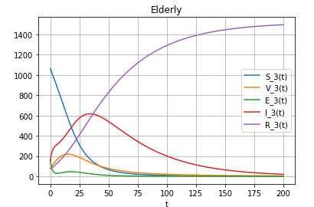
Example: Children staying home when sick
Child to child disease spread happens at an increased rate when children attend school while sick
𝛃_11 is relatively large compared to other parameters
Leads to increase in E_1 population, which then leads to an increase in E_2 and E_3 even if corresponding 𝛃_12 and 𝛃_13 are relatively small
𝛃_11=0.01 >4*𝛃_ij

Slide 18
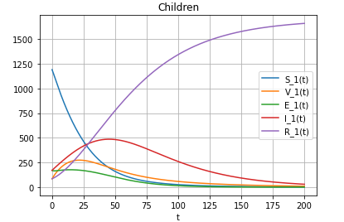
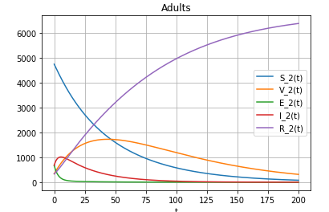
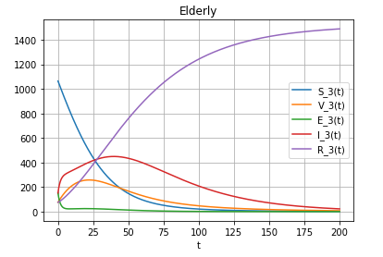
Example: Children staying home when sick
Ensure that sick children stay home until they’ve fully recovered
𝛃_11 should be smaller than other parameters
𝛃_11’<<𝛃_11
𝛃_11’=𝛃_11/100

Slide 19
What’s Next?
Current limitations include the fact that recovered individuals can’t get a mutated disease again.
We can extend the three population ESIRV-model to an arbitrary amount of populations (with 5xN equations).
We can add in spatiotemporal parameters
We could take into consideration birth and death rate
Consideration of natural immunity or vaccination distribution
We can account on different death rates for different populations that are infected.
Varying zeta (Vaccine efficacy) for different populations/age groups.
Accounting for Maternally-Derived Immunity (M parameter used in other models)
Solving the problem of how difficult it is to get accurate disease information

Slide 20
Member Contribution
Ryeder- Python Code/Generating Plots
Umut- Research/Slide show
Joshua- Topic/Idea generator, LaTeX writer

Slide 21
Sources used:
https://www.ncbi.nlm.nih.gov/pmc/articles/PMC6800178/ (Infection rate of Measles)
https://wwwnc.cdc.gov/eid/article/25/1/17-1901_article (R₀ definition)
https://www.nytimes.com/2020/04/23/world/europe/coronavirus-R0-explainer.html (R₀)
https://wwwnc.cdc.gov/eid/article/26/7/20-0282_article (R₀)
https://pubmed.ncbi.nlm.nih.gov/28757186/ (R₀ Measles)
AIP Conference Proceedings 2264, 020003 (2020); https://doi.org/10.1063/5.0023439
https://arxiv.org/pdf/1809.02956.pdf (SIR variations)

Slide 22
Code
The project was coded in Python on the Google Collaboratory IDE, you should be able to run it at this link: https://colab.research.google.com/drive/1wSa-R0BI3Ev6W2Q3fLnr7s_8SwmjWJbE?usp=sharing

